Slide 1
I can…
STNS
2022/23

Slide 2
September – I can…
Focus on attention and listening​
Follow Daily Routines and Recognise my Symbol​
Explore Mark Making​
Explore book corner
Talk about myself, families and nursery​
Talk about who works in nursery​
Recognise and use weather board. ​
Identify basic colours: Red, Blue, Yellow and Green​
Explore resources in home corner​
Participate in rhymes and songs
Able to tidy away toys – matching visuals​
Use school rules – gentle: hands, feet, voices​
Begin to put on coat and boots​
Begin to show independence snack time​
Increase confidence outside
Learn to say ‘hello’ in our native tongues

Slide 3
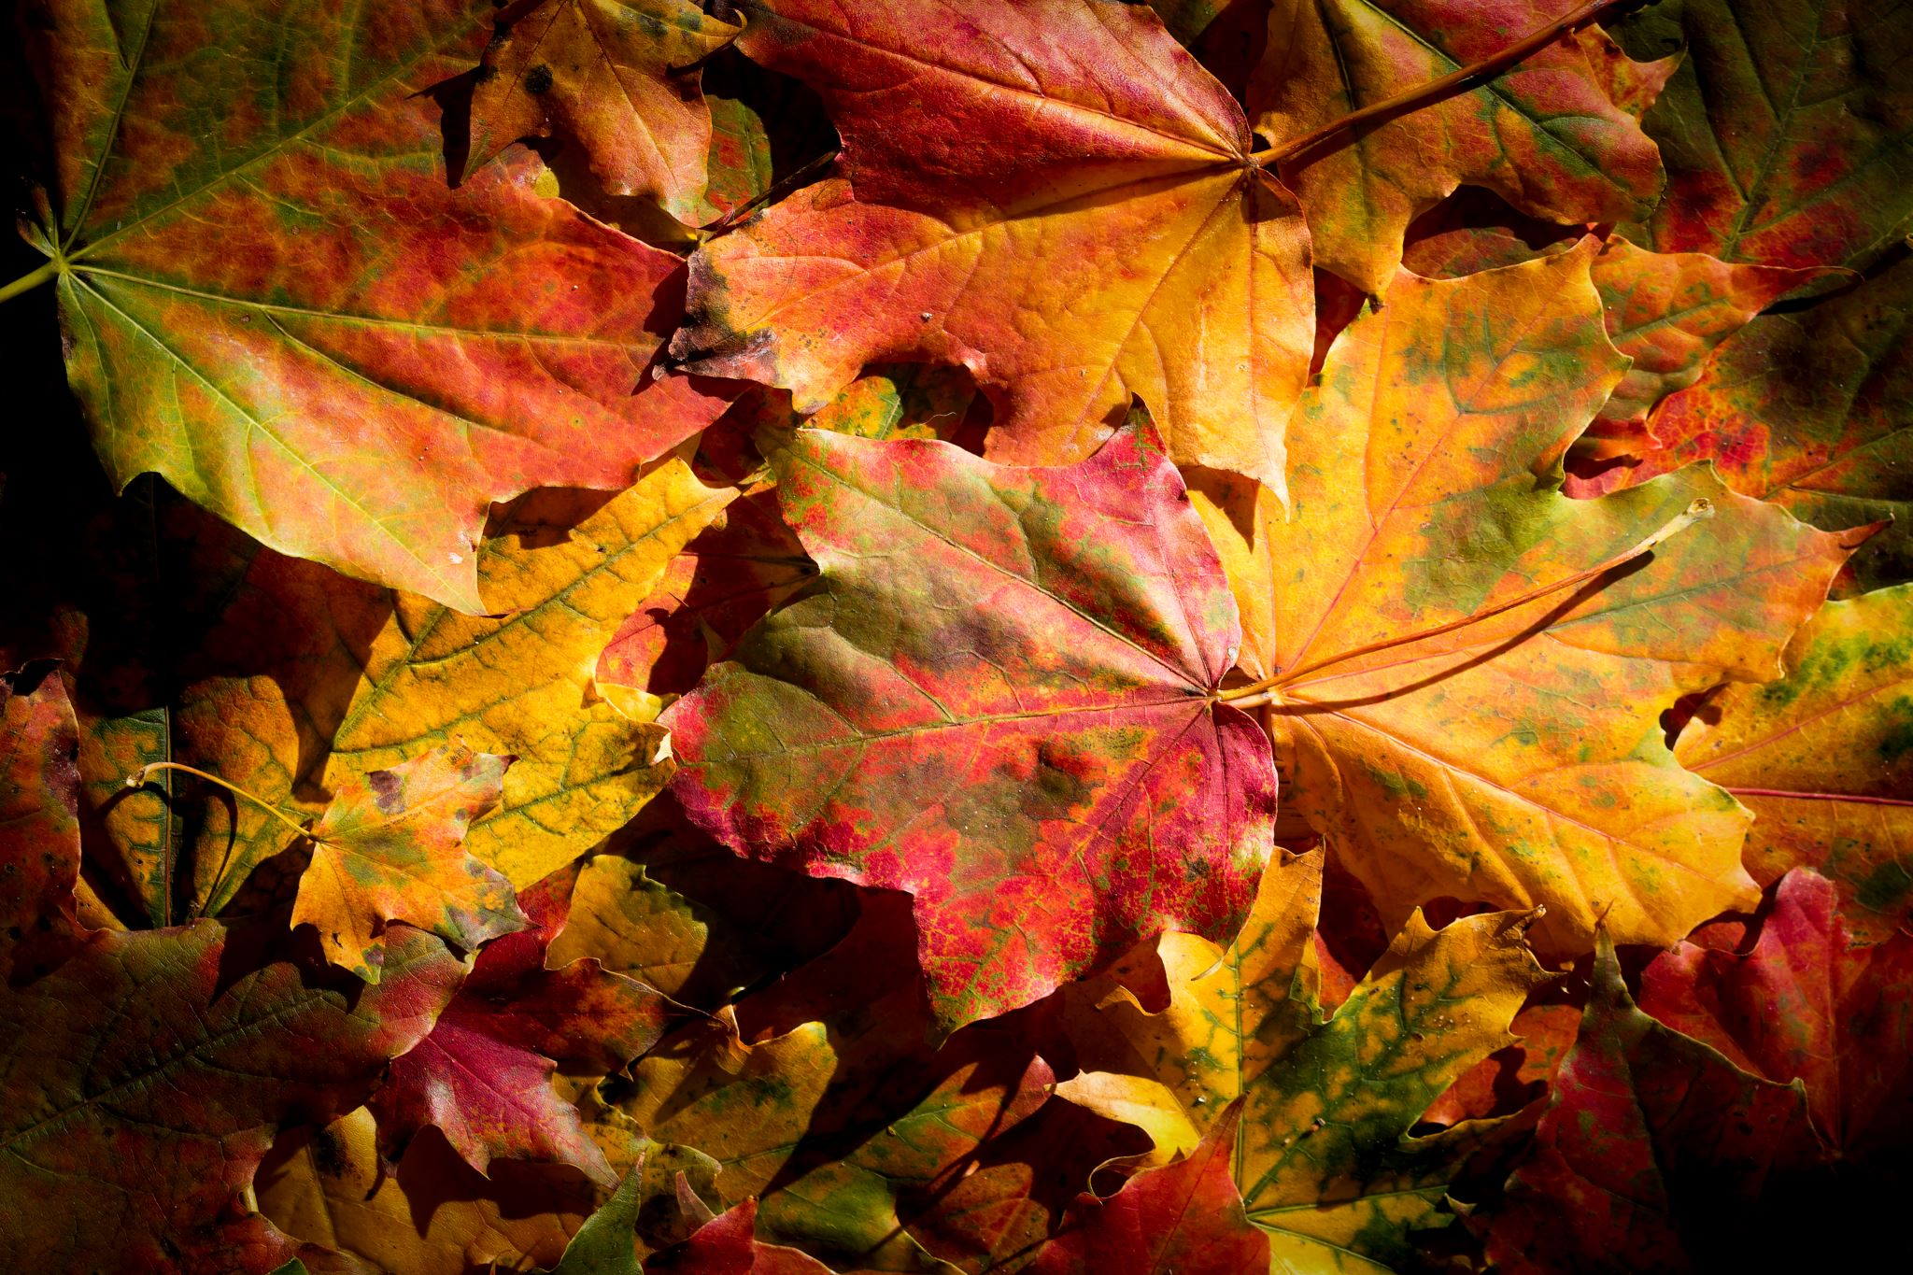
October – I can…
Following simple instructions​
Converse with others
Role Play and play with Small Worlds​
Sit for short story​
Be familiar with Topic Tree
Begin to name main body parts ​
Try new foods and describe taste​
Get to know names of plants/herbs in garden​
Be aware that living things need food and water​
Plant bulbs and seeds​
Talk about festivals /seasons/​
Recognise and identify Autumnal colours: orange, brown, yellow, red​
Sing songs and rhymes related to Autumn and Halloween​
Help prepare snack ​
Pour drinks​
Play near others​
Enjoy praise/express emotions​
Resolve conflict with adult support
Use mathematical language – more/less​
Join in number rhymes and songs​
Know how many people can play at each area​

Slide 4
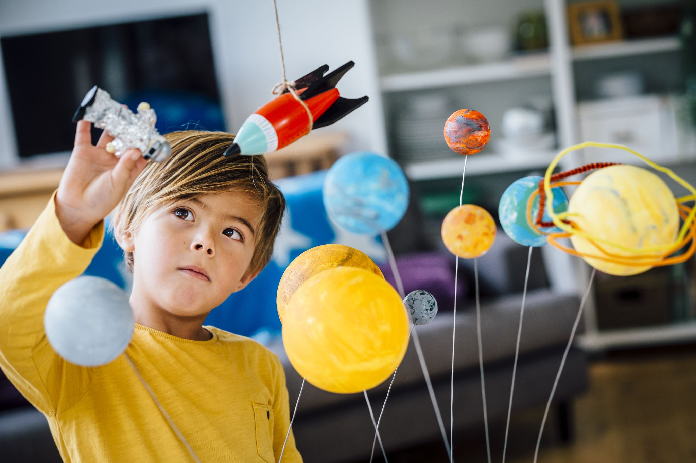
November – I can…
Identifying sounds in the environment. Record on iPad.​
Listen and join in songs in class​
Extend my vocabulary and add to Topic tree​
Show interest in books​
Match shapes, pictures, patterns, colours.
Talk about the difference between night/day
Recognise uniqueness of self-height, hair colour, body parts, gender, interests​
’Be safe be seen’ at night and in morning ​
Observe patterns around me-Rubbings from grates, covers, bricks​
Begin to cut stick and build with junk
Use equipment safely​
Observe physical boundaries
Explore fluorescent colours ​
Make patterns
Create models with junk materials​
Engage in space role play and small world materials​
Explore areas of interest with magnifiers, magnets, mirrors, feely box and natural materials​
Make musical patterns
Increase my independence at snack​
Express social communication – please, thank-you​
Express preference​​
Play near and with others​
Be more aware of other's feelings – begin to inhibit actions which may hurt others – physically or emotionally
Show interests in shape indoors and out​
Talk about shape of everyday objects – round/tall​
Talk about immediate past and future e.g. before or later

Slide 5
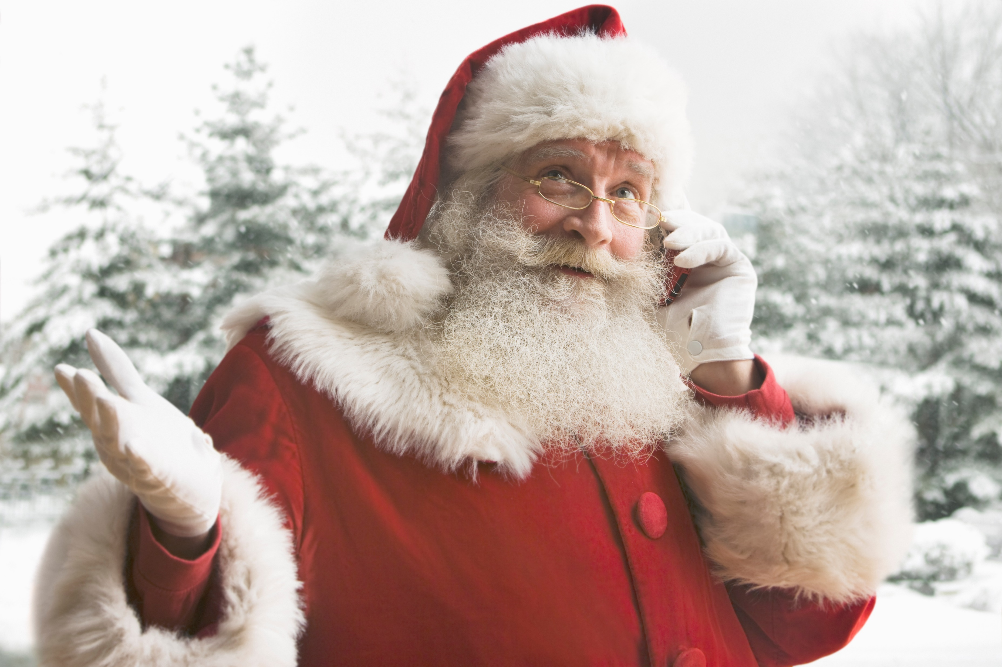
December – I can…
Perform songs for audience in Nativity/Advent Service​
Mark make – Letter to Santa/Christmas Cards​
Develop and understanding of positional language and prepositions 'in front', 'behind', 'in', 'on', 'under', 'beside'​
Find and sort clothes – talk about size – big/small
​Introduce metallic colours – silver, gold, bronze​
Use enlarged projectory to support building/construction play, creativity and awareness of local environment
Listen to a simple story and retell – link to 6 Bricks​
Begin to recall what has happened
Show curiosity in the environment – number hunt walk​
Show awareness of similarities of shapes in environment​
Engage in sequencing activities – such as dressing doll from inner to outer clothing​
Understand they must observe and respect their own and others space
Identify familiar natural/man-made sounds in environment – birds, wind, rain, traffic, vehicles, ​
Talk about how we prepare for Christmas​
Begin to talk about their observations , make simple predictions.​
Begin to use tape to join. ​
Develop cutting, sticking, folding, pouring, and build ​
Explore floating and sinking
Begin to use compliments with friends – thank you for using nice manners​
Enjoy carrying out small tasks​
Help give comfort when others are distressed.​
Persevere with tasks​
Demonstrate creativity​
Approach tasks with an eagerness to learn​
Concentrate and complete tasks

Slide 6
January – I can…
Follow 2 part instructions​
Recall main events from Christmas holidays​
Extend vocabulary related to seasonal change and bird​
Mark make for meaning – recording bird tally​
Name more parts of the body- eye lids, eye lash, freckles, nostrils​
Notice similarities and differences​
Understand they need different clothes for different conditions​
Talk about the changes in the weather and different seasons​
Continue to join in number rhymes and songs​
Recite numbers to 10​
Continue to use 'long'/'short'​
Full/empty​
Understand size/quantity​
Understand concept zero
Observe bird and create 2D representation using a variety of media​
Create transient art – using natural and commercial materials​
Explore new resources in home corner​
Participate in rhymes and songs​
Use and make hand puppets ​
Explore properties of malleable materials
Become more familiar with nursery environment indoor/out​​
Be independent in bathroom​
Use and select equipment appropriately​
Can tidy with increasing independence​
Understand the importance of wearing appropriate clothing​
Take turns and share
Concentrating for extended periods of time

Slide 7
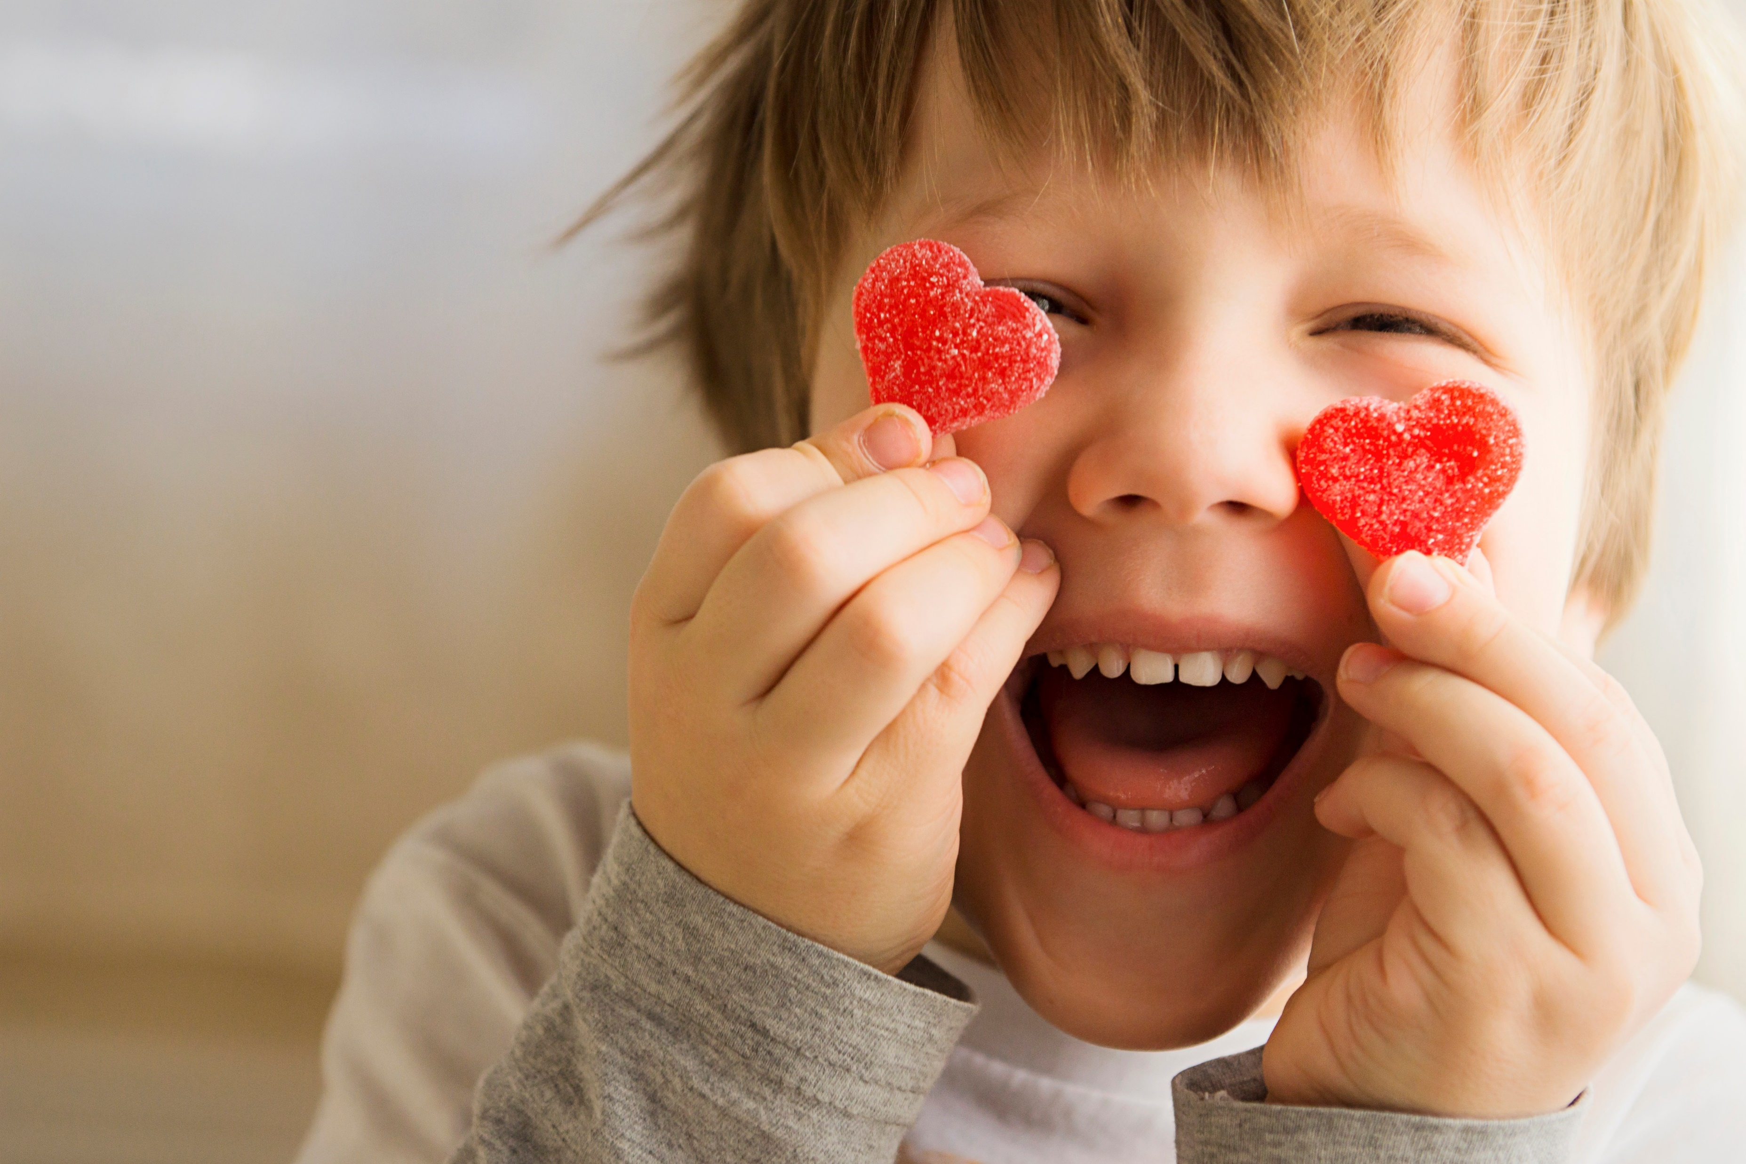
February – I can…
Identify key roles in the community​
Understand people who help us​
Extend vocabulary in role play ​
Listen and participate in new and familiar songs and rhymes
Draw in clay​
Make patterns ​
Explore areas of interest with magnifiers, mirrors, feely box and natural materials
Able to dress with increasing independence – coats, hats, gloves, shoes etc (with minimal support)​
Independent at snack​
Beginning to eat dinner with knife and fork​
Forming special friendships ​
Expressing social communication – excuse me, please, thank-you​
Showing creative and critical thinking during tasks
Articulate likes/dislikes in terms of stories/activities​
Talk about similarities and difference in children​
Understand we all live in different houses​
Recognize the role of people who work in our community​
Begin to talk about where we live – road, path, city​
Talk about grandparents and why we love them​
Become more familiar with different areas of school e.g. Butterfly garden
Begin to recognise numerals 1 to 5 and beyond​
Begin to match numeral and quantity correctly ​
Recognise numbers using fingers, marks on paper, pictures​
Find 2D shape names in nursery environment​
Recognize patterns in environment ​
Find different ways to measure

Slide 8
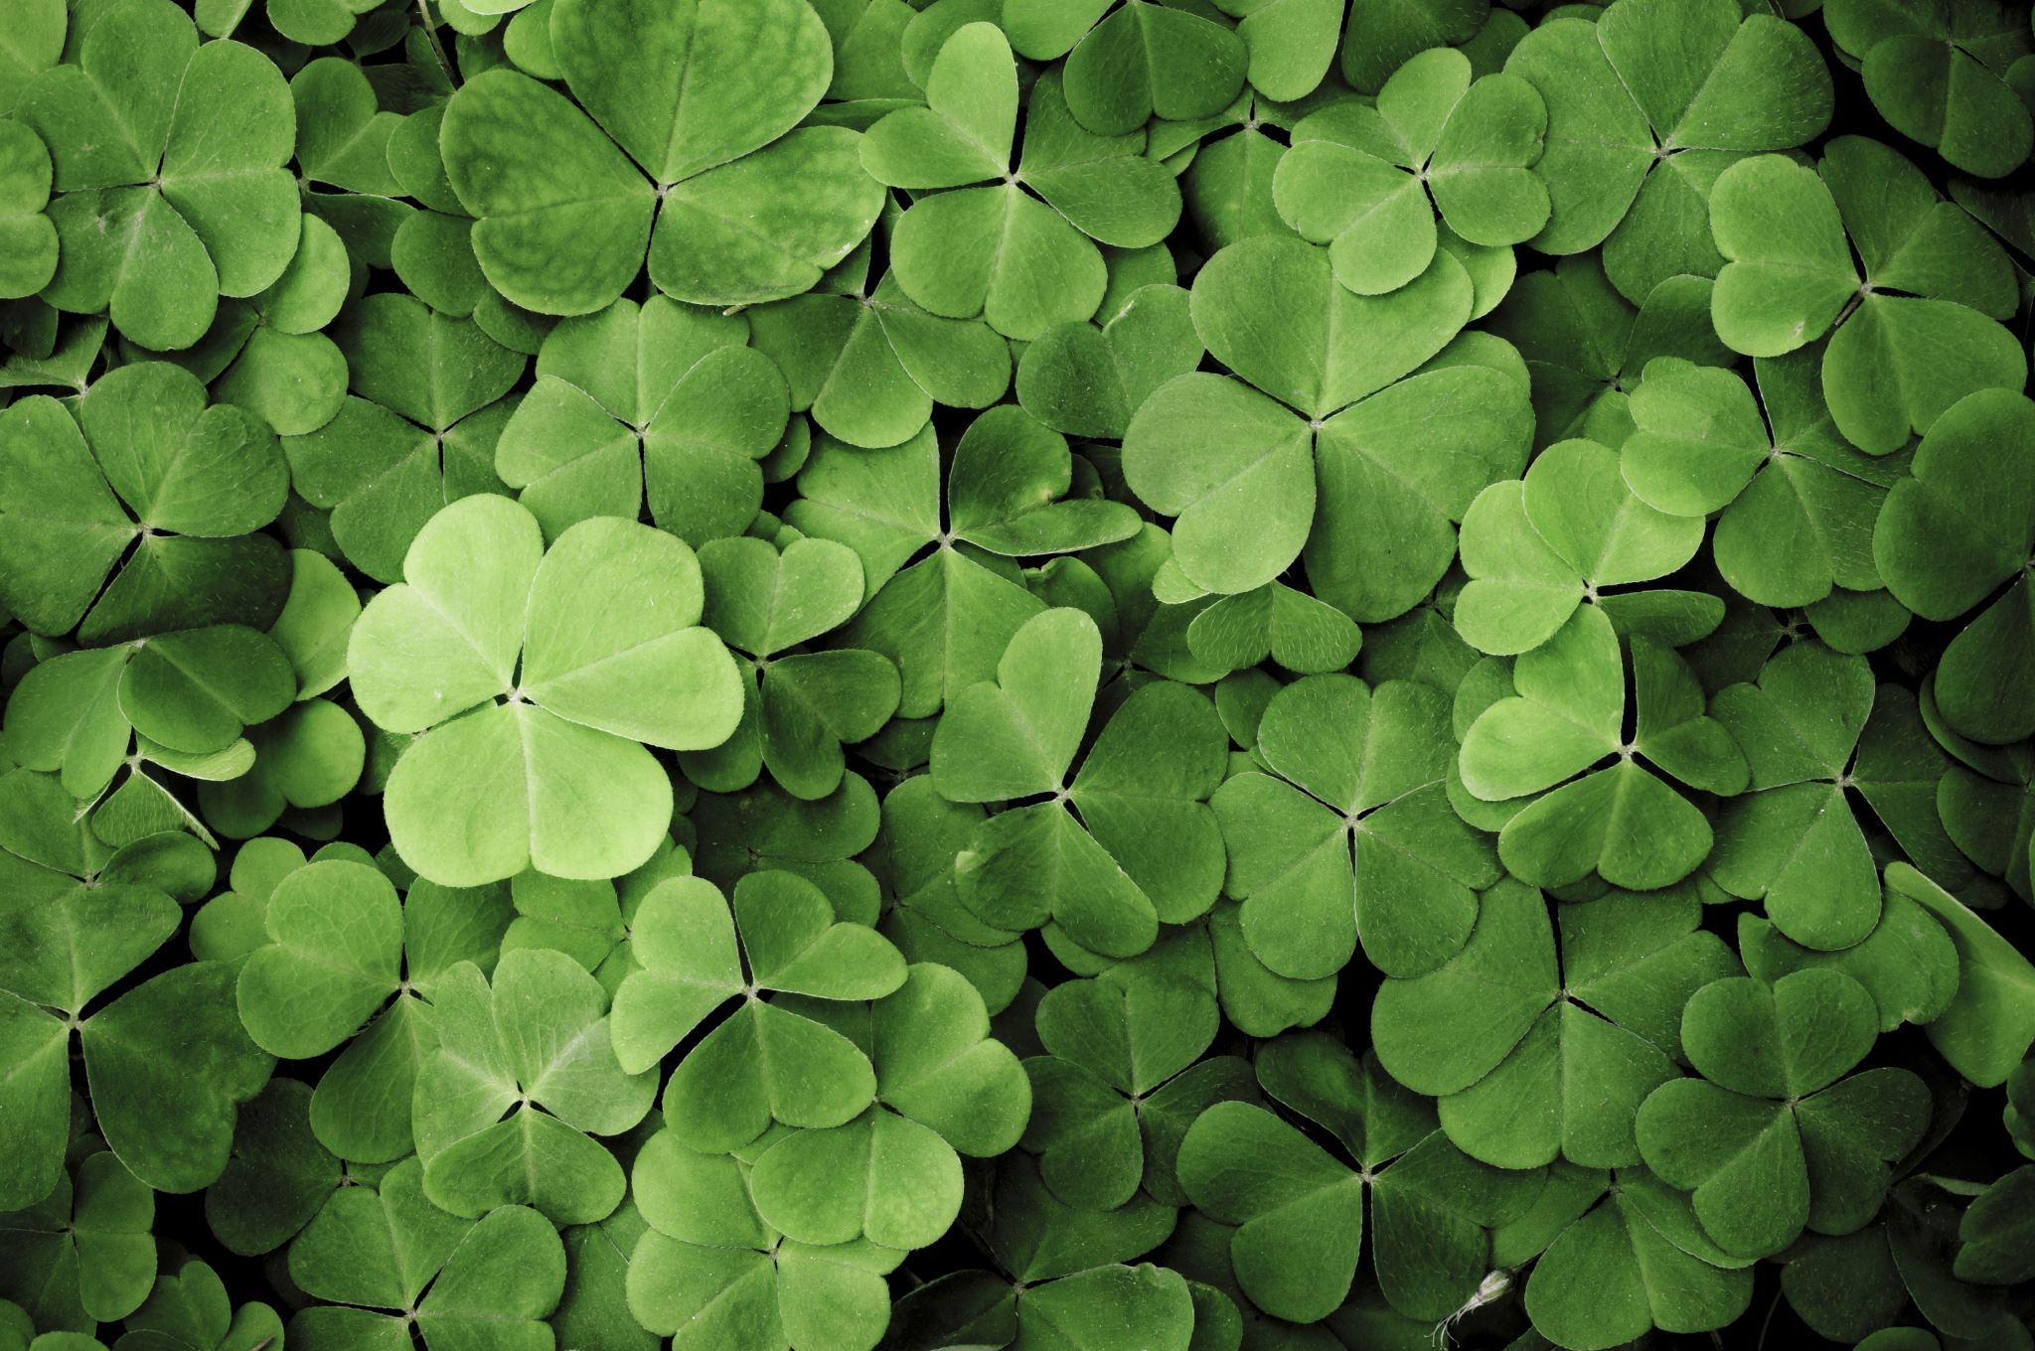
March– I can…
Participate in group story time on mat and recall main parts​
Access a wide range of topic books looking at new life and life cycles.​
Grow in confidence when sharing news with teachers and peers during ''Good News' session on mat​
Participate in Word Book Day activities - nursery rhyme scavenger hunt, book covers and pictures
Draw with clay ​
Add white and black to green to create different shades​
Engage in a variety of St. Patrick's craft activities​
Participate in Wee Folk– traditional music performance​
Use enlarged projectory to look at St. Patrick's day celebrations in the local environment
Begin to count objects accurately ​
Display confidence in estimation​
Begin to use mathematical names for shapes​
Use mathematical language to describe shapes side, edges​
Compare sizes ​
Understand language more /another​
Help sequence events using photographs
Begin to recognise personal history and sense of family/community​
Recognise and name basic features of their home (window, roof, door)​
Observe changes in materials - liquid to solid​
Begin to question how things work​
Begin to talk about simple predictions – what would happen if water is added to sand​
Consider properties and how they can be stuck together​
Observe growth of bulbs planted in Autumn
Aware of safety of self and others​
Able to select activities and use resources with greater independence​
Be more independent in preparing food at snack time, pour drinks, chose what to eat and when​
Be more confident in social situations​
Play in a group, extending, elaborating play ideas​
Continuing to develop relationships with adults and children​
Giving compliments and praise to each other

Slide 9
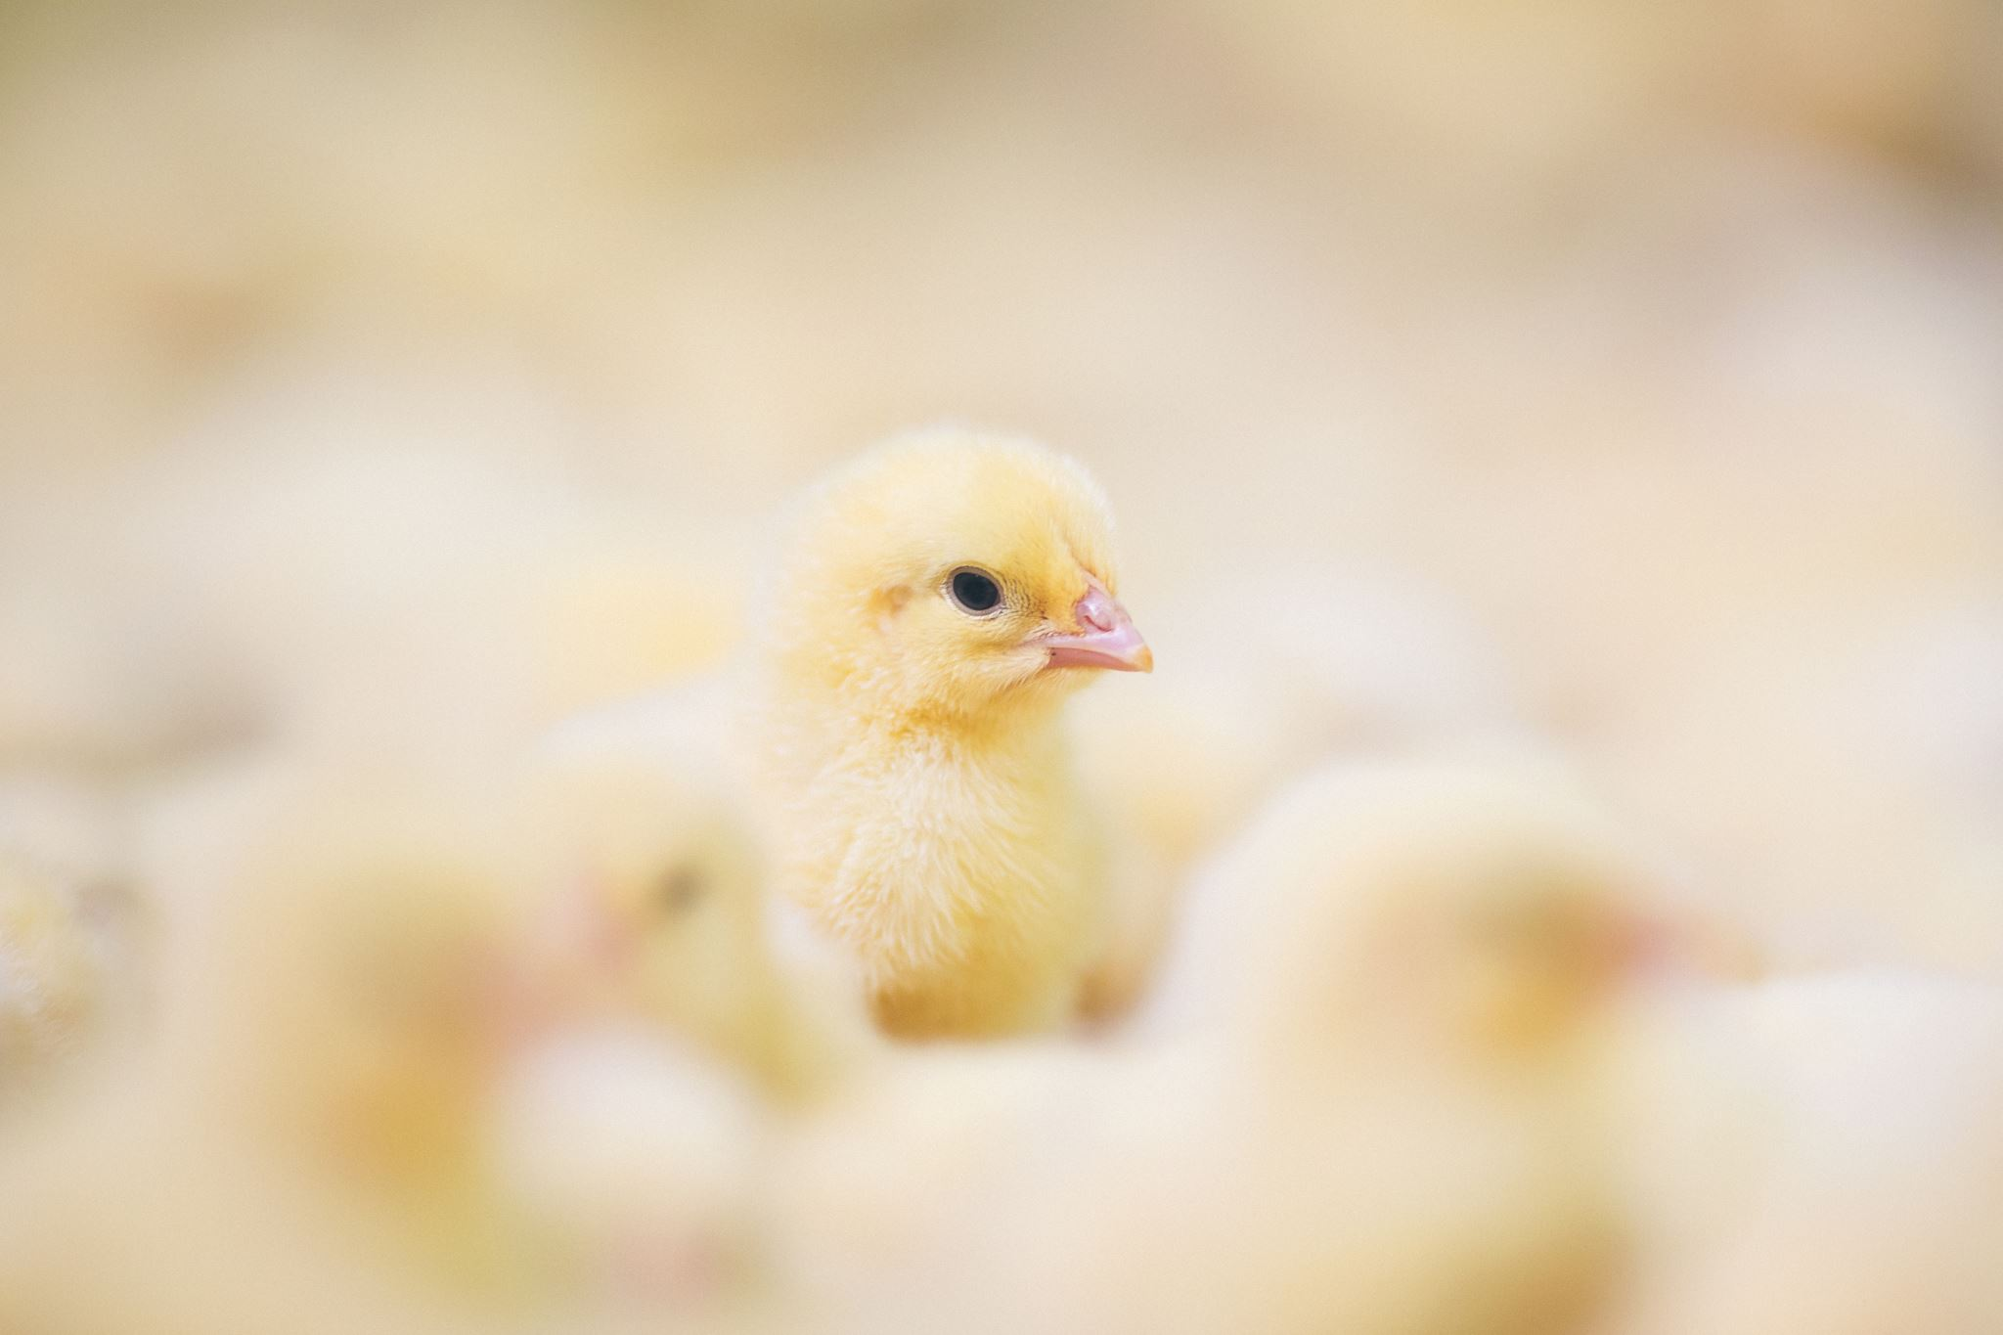
April– I can…
Extend vocabulary during Topic tree discussions about farm animals and mother/baby discussions
Highlight achievements – able to climb, made new friends​
Continue to develop awareness of healthy eating habits and lifestyles and the increased opportunities as the year progresses​
Begin to be aware of the feature of our local landscape ​
Find out about the environment by talking to people, examining photographs and simple maps
Identify prepositions during Easter Egg hunt – over, under, on top etc.​
Check colours/number/shape​
Recite numbers to 10​
Continue to use 'long'/'short'​
Full/empty​
Understand size/quantity​
Sort items by length/height
Health and Self Care –importance of handwashing around farm animals
Develop painting skills through use of paint palette and water​
Explore colour though examining the results of accidental/intentional colour mixing and talking about the outcome​
Investigate ways to make homes for animals – how can we make them stable​
Move to beat of music – Easter Parade
Developing social skills and turn taking during circle time activities​
Play and use money in appropriate context​
Find and replace resources and belongings independently​
Able to dress with independence– coats, shoes, hats ​
Aware of and using visual timetable​
Independent at snack​
Perseveres with activities for extended periods of time

Slide 10
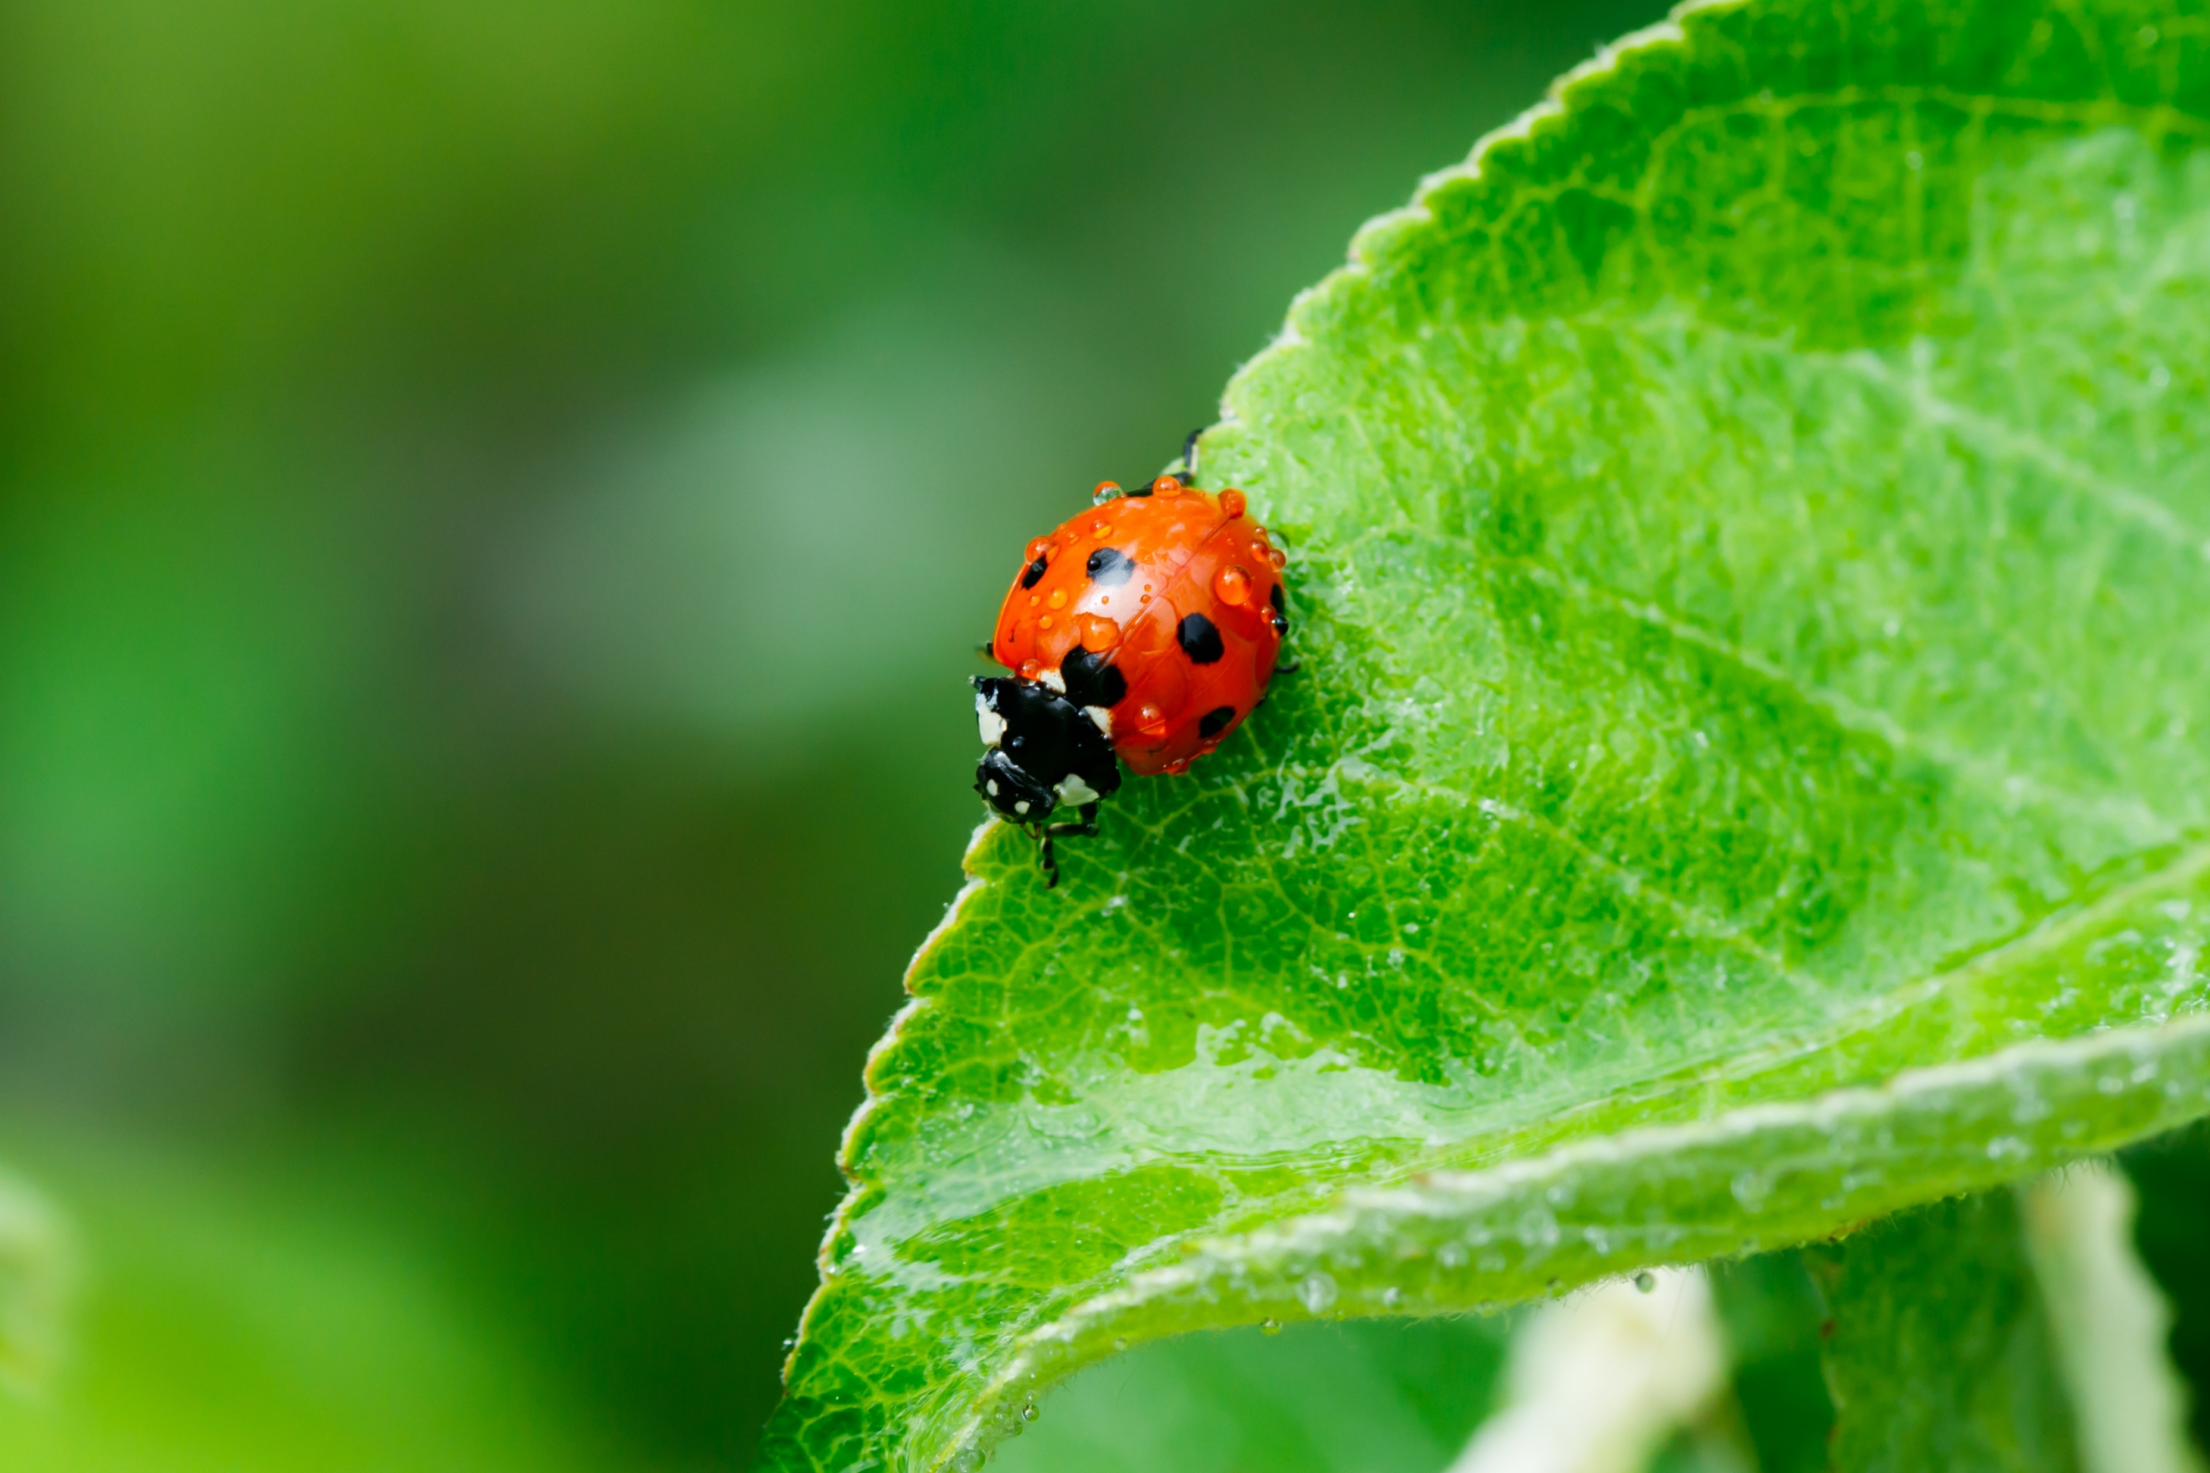
May– I can…
Recognise print in their environment​
Explore mark making using all media indoors and out​
Identify May as the Month of Mary – learn 'Hail Mary'​
Extend vocabulary during Topic tree discussions about minibeasts and jungle animal's habitat and camouflage– patterns –stripy, spotty etc.
Block printing with clay​
Use a variety of objects to create pictures ​
Add fabric and paper to drawings​
Use various tools when working with clay​
Recognise numerals 1 to 5 and beyond​
Match numeral and quantity correctly within 5​
Represent numbers using fingers, marks on paper, pictures​
Use 2D shape names in nursery environment​
Recognize and create patterns with a variety of media​
Use rainbow sticks to create shapes and measure indoor and out
Discuss how we have grown since start Sept.​
Consolidate discussion Healthy Eating​
Talk about observations and make simple predictions about things​
Demonstrate an interest in and care for the environment, plants, animals, fish etc​
Investigate how things work/move​
Make simple stop go movies
Demonstrates friendly behaviour and initiates conversations​
Keeps play going, by responding to what others say/do​
Initiates play and offers cues to peers to join them ​
Confident to talk to other children when playing​
Able to resolve conflict with minimal adult support​
Able to adapt behaviour to different social events
Take part in Sports Day
Move freely to music – scarfs/ribbons​
Make and use own musical instruments

Slide 11
June– I can…
Recognise and begin to print own name​
Participate in graduation songs and rhymes and perform for audience​
General discussion about starting P1 and looking at badges, colours of new uniforms​
Extend vocabulary during Topic tree discussions about under the sea, holidays. ​
Encourage descriptive language to describe sea creatures
Communicates freely about own home and community.​
Form special friendships
Be more accepting of the needs of others ​
Able to take turns and share​
More aware of feeling of self and others ​
More tolerant when needs are not met
Use technology to create music
Follow sun safety message​
Observe that change that may be reversed e.g. wilting leaves, melting ice, rotten apples​
Observe how shadows can be changed​
Create lines which make up shapes and images using: cord, rope, hoops, sticks – indoors and out​
Increase media to develop and enlarge transient art experience indoors and out​
Draw pictures from direct observation ​
Count objects to 10​
Display confidence in estimation​
Begin to use mathematical names for 3D shapes​
Use mathematical language to describe shapes 'faces;, 'sides'​
Compare sizes to include middle-sized​
Use language of more /another​
Use photographs to sequence events

